Slide 1

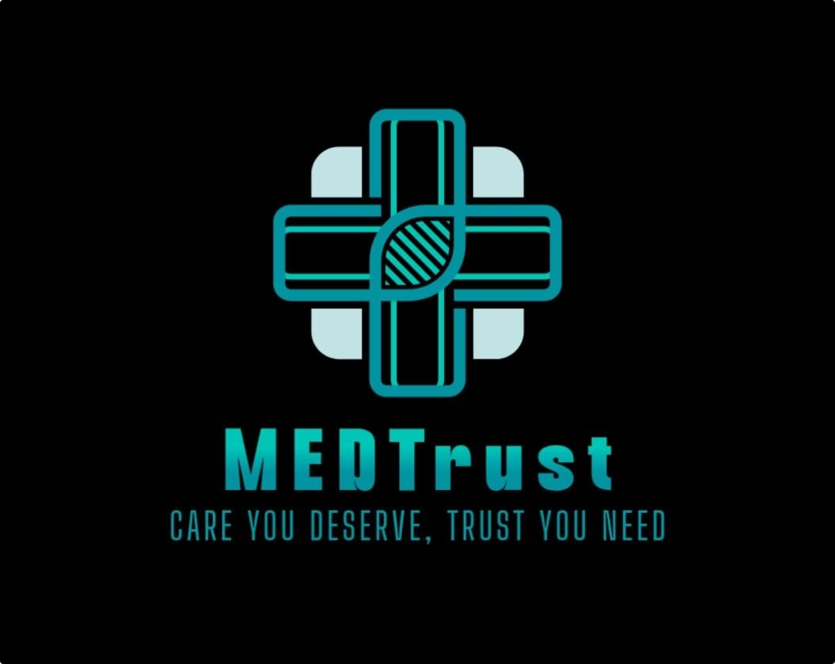
MEDTrust:
✅ Connects Communities to Care 🤖 AI-Powered Medical Support 🔒 Privacy-First & Secure 🏥 Find Camps & Consult Doctors 💊 Decode Prescriptions 📜 Get Insurance Info
Your Health, Your Trust! 💙

Slide 2

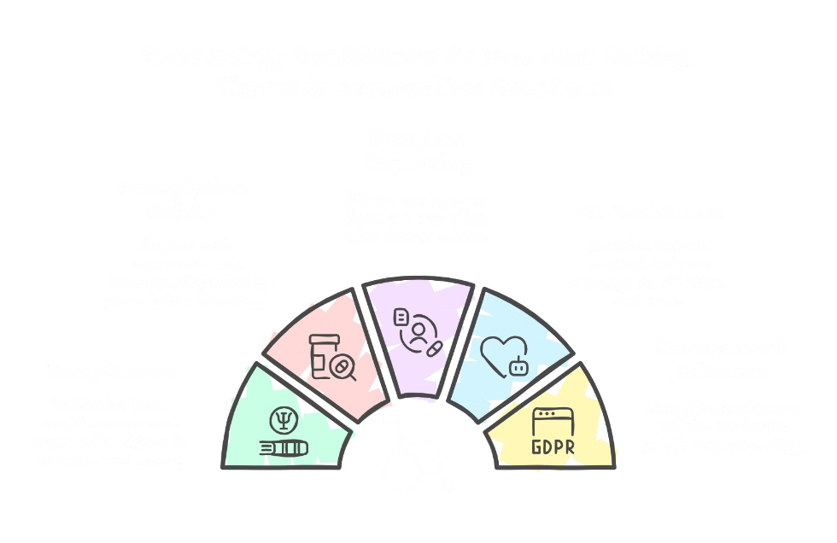
Benefits for Patients

Slide 3
Accessible Healthcare Information for Patients
User-Friendly Platform
Prescription Decoding
MEDTrust offers an intuitive platform that delivers medical information in an easy-to-understand format. No more struggling with jargon!
Complex prescriptions are translated into simple language, ensuring patients know exactly what their medications are for and how to take them.
Simplified Medical Information
Easy-to-Understand Format
Promotes Informed Decisions
With MEDTrust, barriers to healthcare knowledge are eliminated, enabling informed decisions. In fact, 70% of users reported a better understanding of their prescriptions within just one week of using the platform.

Slide 4

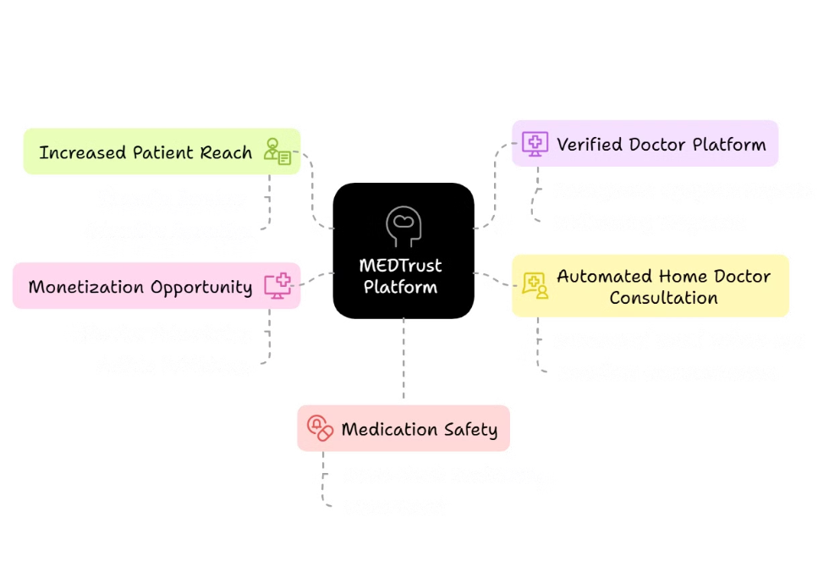
Advantages for Doctors

Slide 5



Data-Driven Insights for Doctors
1
Personalized Treatment
2
Proactive Healthcare
3
Improved Accuracy
MEDTrust offers AI-driven analysis of patient data for personalized treatment. Doctors can also identify trends and patterns for proactive healthcare interventions. Using the platforms results in a 15% improvement in diagnosis accuracy.

Slide 6

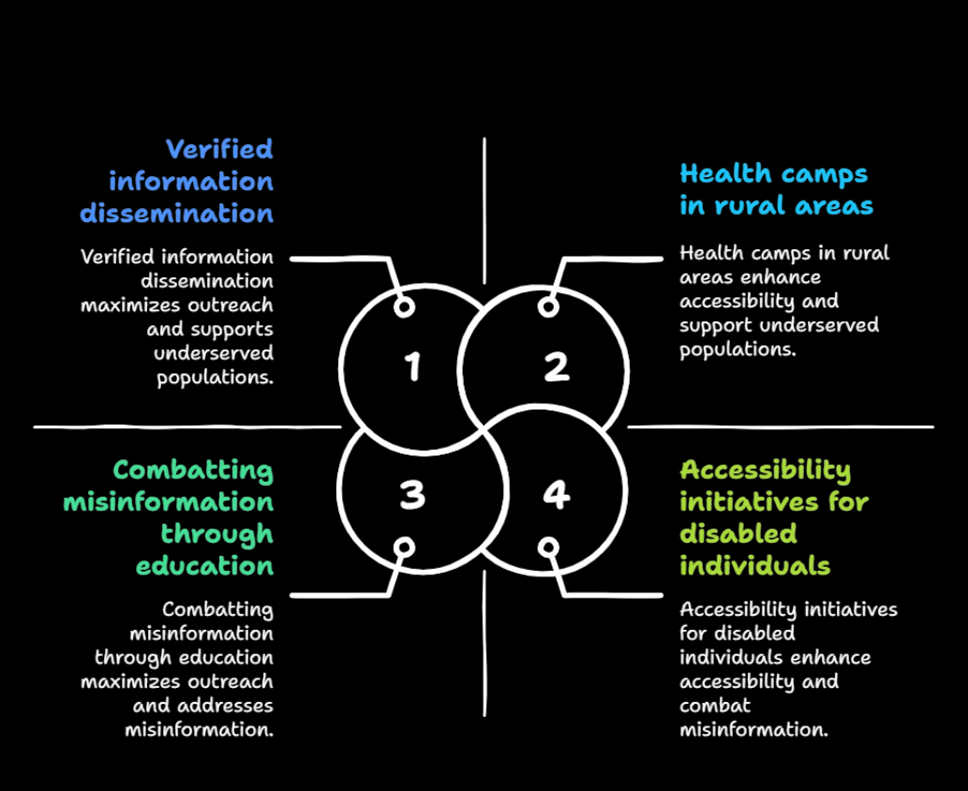
Strategic Benefits for NGOs and Health Organizations

Slide 7
MEDTrust: Opportunities for NGOs
Extend Impact
Streamline Delivery
Collaborate Effectively
MEDTrust enables NGOs to extend their reach and impact in underserved communities, bridging the gap in healthcare access.
The platform streamlines healthcare delivery and resource allocation, ensuring that resources are used efficiently and effectively.
NGOs can collaborate seamlessly with healthcare centers for impactful community health initiatives, creating a unified approach to healthcare.

Slide 8

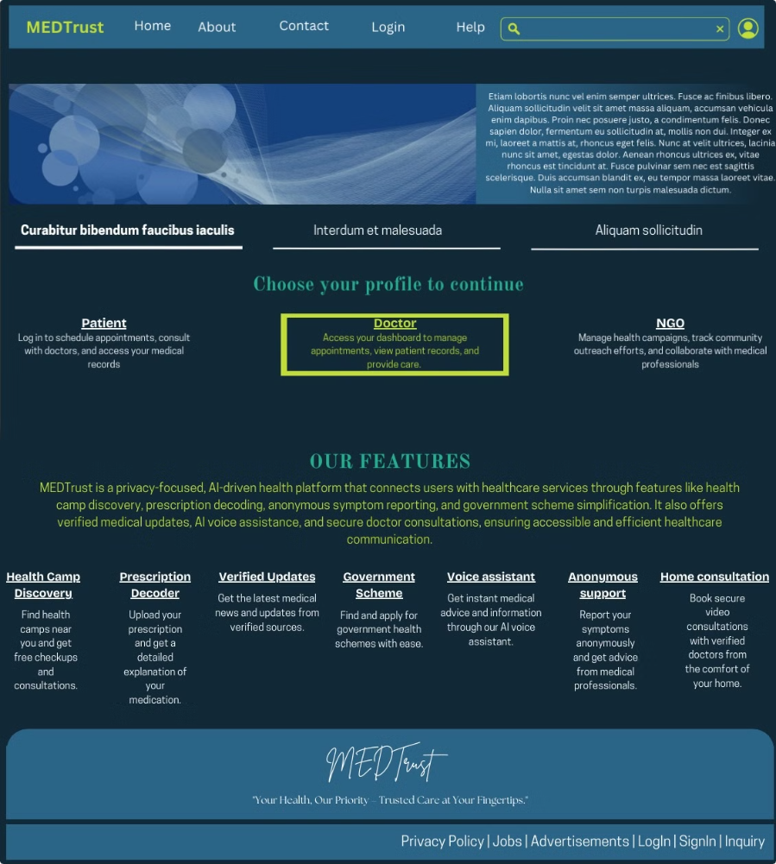
Vision of how our website will look like in the future.

Slide 9
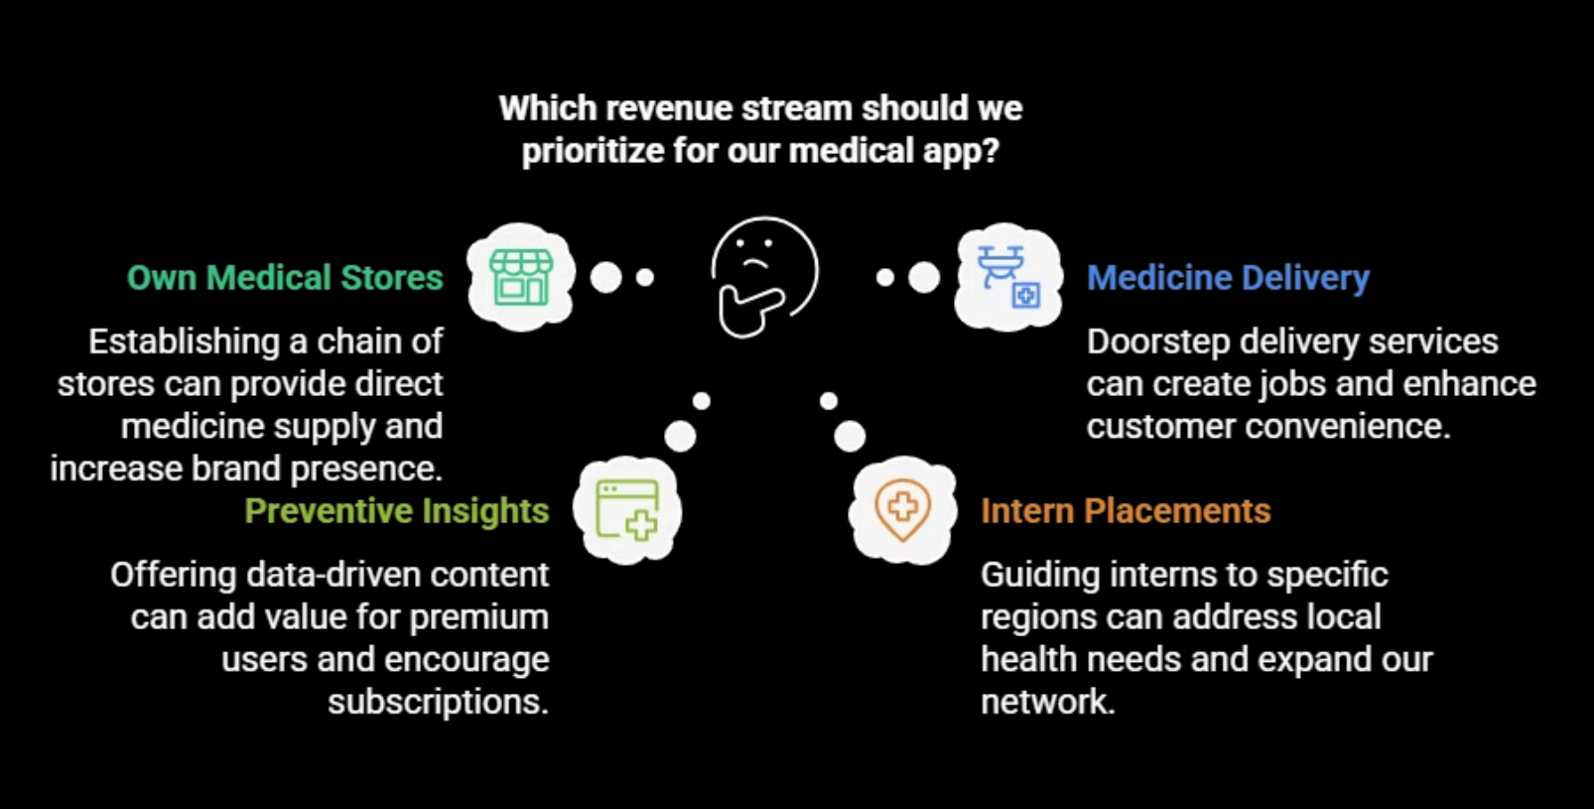
Future Plans:

Slide 10
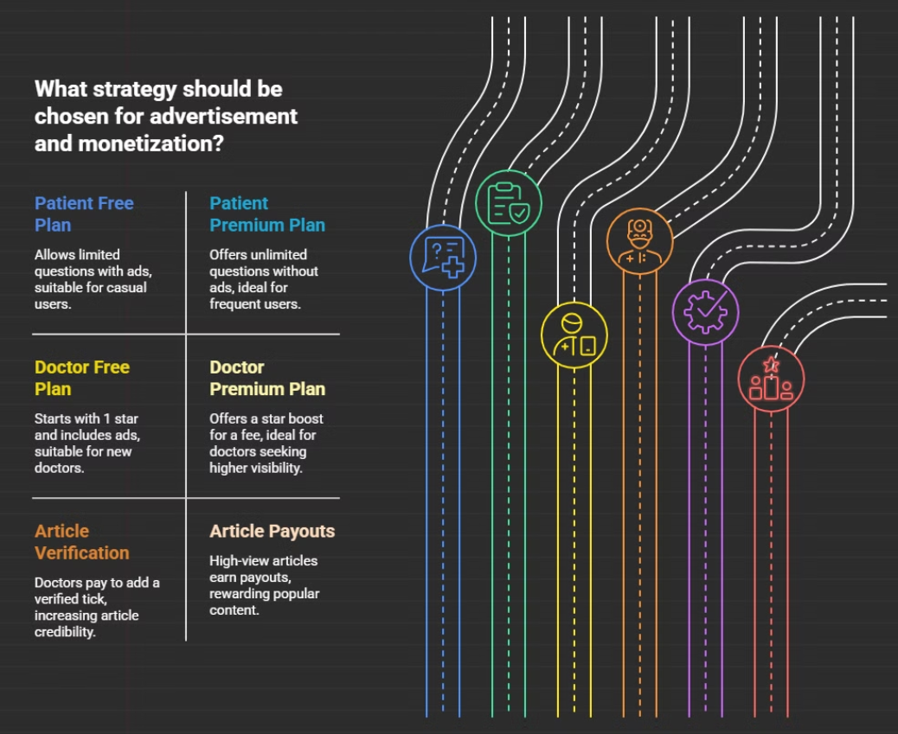
Advertisement and Monetization Strategy:

Slide 11
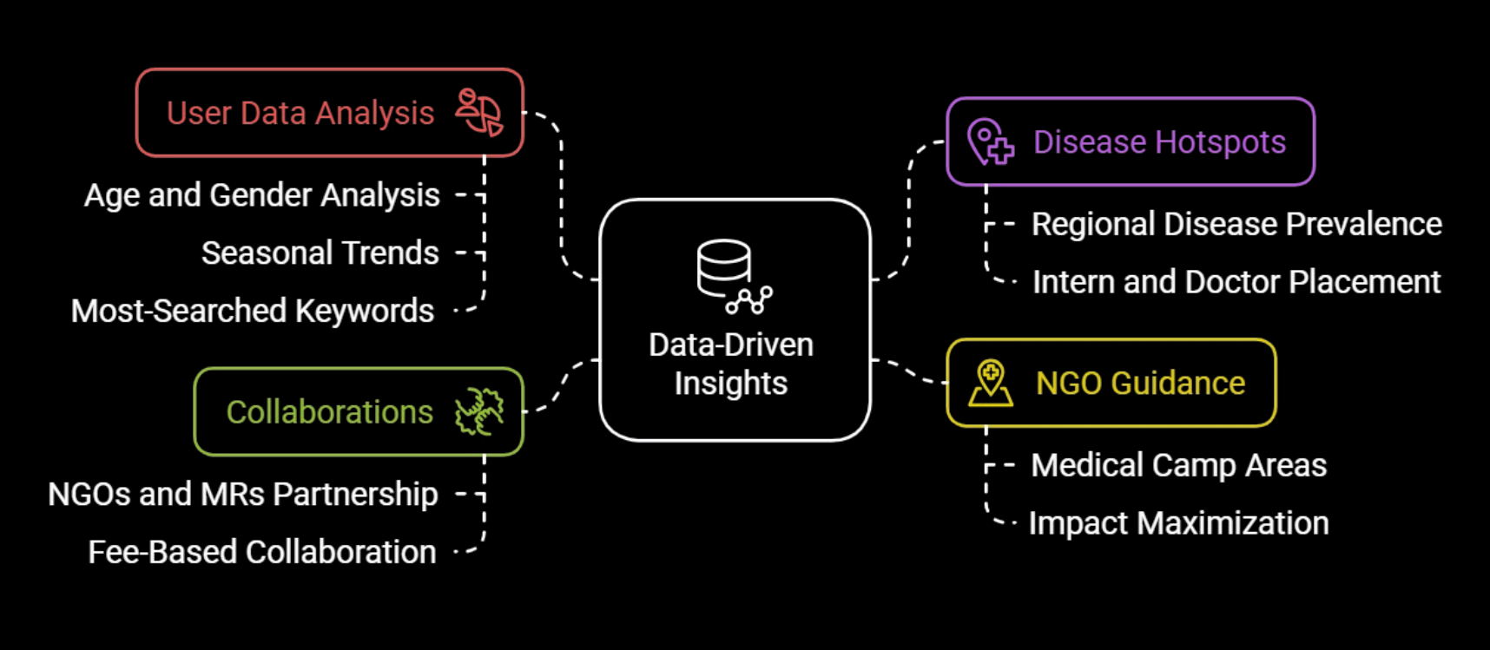
Data-Driven Insights for Revenue Streams

Slide 12
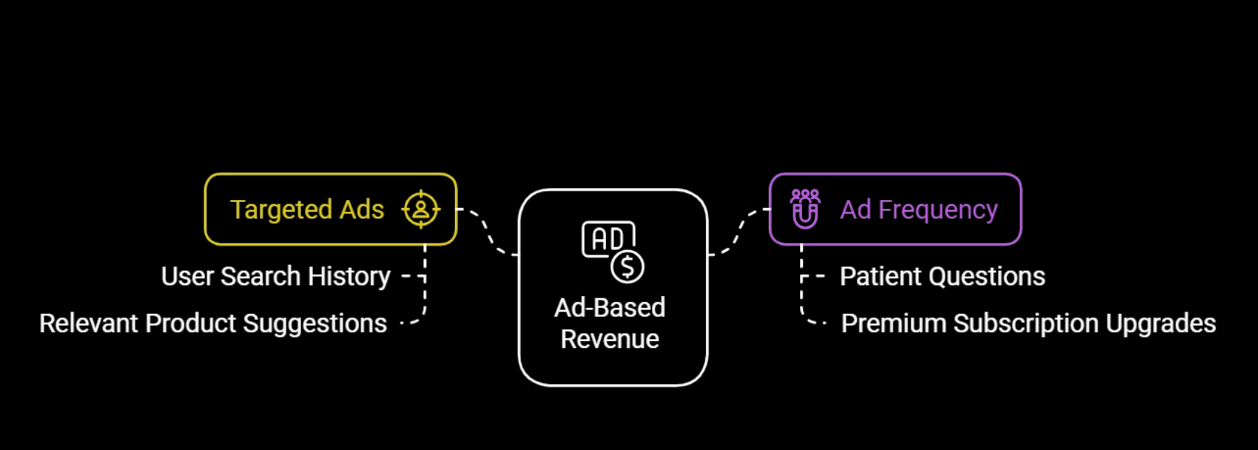
Ad-Based Revenue Strategy

Slide 13

MEDTrust: A Collaborative Future of Healthcare
MEDTrust empowers patients, doctors, and NGOs with secure, cutting-edge technology, redefining healthcare access. 🌍💙 By bridging gaps and driving innovation, we create a future where healthcare is accessible, efficient, and secure for all.
Join us in transforming healthcare—one connection at a time! 🚀

